Slide 1

Where to Relocate in California after the COVID-19?
Applied Data Science Project Capstone Project
Dai Li

Slide 2
Introduction and Business Problem
After the World Health Organization (WHO) declared the COVID-19 outbreak a global pandemic, many areas in the world issued the stay-at-home order.
An interesting result of work-from-home is that people realize the business goes just fine when employees work from home in pajamas. Many people start to look for a place that fits their life needs and styles as they can work anywhere.
This project is to provide insights for those people who look for relocation cities in California.

Slide 3
Data Needs
Based on the business problem of this study, four types of data are needed for this project:
Safeness - crime statistics of the city
Education Quality - public school system data
Home Affordability - medium home value based on real estate data
Lifestyles - the most common venue categories

Slide 4
Data Acquisition
Four data sources are used for this project:
California Offenses Data by County and City: a dataset containing the crimes submitted either through a state Uniform Crime Reporting program or directly to the FBI’s program.
US Schools Dataset: the dataset taken from the US Department of Homeland Security and contains information of all public schools with their geographical distribution.
Housing Data: the dataset downloaded from Zillow Research which contains the seasonally adjusted measures of the typical home value in the 35th to 65th percentile range.
Dataset of the Neighborhoods, boroughs, and the most common venues along with co-ordinates: This data will be fetched using Four Square API to explore the neighborhood venues.

Slide 5
Data Cleaning and Description (1)
For California crime data, a new variable is created as the indicator of the city safeness – Crime Density, which is the total number of reported crimes divided by the population of the city. The cities of the highest and lowest crime densities are:
City | Crime Density
Industry | 0.173
Vernon | 0.181
Sand City | 1.134
City | Crime Density
Los Angeles | 14052.2
San Jose | 2071.2
San Diego | 1802.4

Slide 6
Data Cleaning and Description (2)
For the school data, a new variable is created as the indicator for the quality of public elementary education – Student-to-Teacher Ratio, which is the total number of students divided by the total number of full-time teachers. The higher this ratio is, the less the education resource the city has. The cities of the highest and lowest ratios are:
City | Student-to-Teacher Ratio
Yuba City | 51.44
San Marcos | 41.02
San Bruno | 30.87
City | Student-to-Teacher Ratio
Yreka | 12.60
Ross | 15.48
Capitola | 16.00

Slide 7
Data Cleaning and Description (3)
The house value data were drawn from Zillow Research. The adjusted mean value of single-family houses sold in October 2020 of the city is used for the purpose of the project. The cities of the highest and lowest house values are of no surprises:
City | SFH Value
Malibu | $4,753,635
Los Altos | $3,790,008
Newport Beach | $3,546,624
City | SFH Value
Tehachapi | $200,309
Fresno | $277,853
Visalia | $289,761

Slide 8
Data Cleaning and Description (4)
After merging three data files together and dropping the unusable data, the final data set has 82 cities. Use those cities to request venue data from Foursquare, the most common venue categories of the cities are obtained. The chart on the right shows the top 10 most common categories.

Slide 9
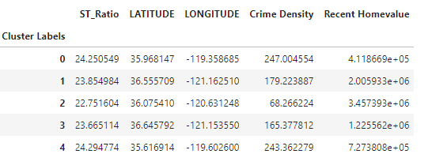
K-Means Clustering
K-means clustering method is used for this project. The number of clusters is set to be 5. The average features of the clusters are shown as below:

Slide 10
Cluster Features
To roughly summarize the key features of the clusters:
(Cluster 0) Away from the ocean, affordable homes (in CA), very high crime density, good places for pizza lovers
(Cluster 1) By the beach, expensive homes, high crime density, much entertainment
(Cluster 2) Close to the beach, most expensive homes, low crime density, high school quality, diverse entertainment and food choices
(Cluster 3) By the beach, expensive homes, high crime density, good entertainments and food choices
(Cluster 4) Close to the beach, still-expensive-but-not-intimidatingly-so homes, very high crime density, high student-to-teacher ratio, and some entertainments

Slide 11
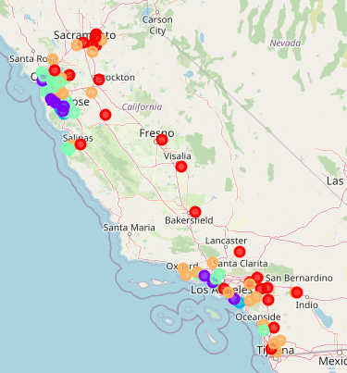
Folium Map
To cast clusters on to the map, we can see the cities in the central area are likely dotted read (cluster 0), but still there are some red dots by the ocean, which implies those cities may be good choices for the people who are fine with the features of the cluster 0 but love the ocean view.

Slide 12
Conclusion
This study is to provide some insights for the people who may be considering relocate in California. The K-means clustering is used to put CA cities with similar features into the same clusters. Hopefully, it could guide the consideration for the people trying to find the places that fit their lifestyles.

